Slide 1
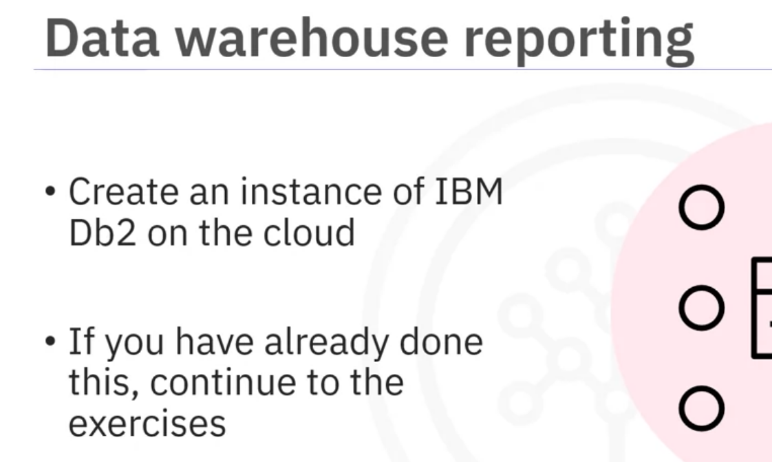
Data Warehousing Reporting
Week-3
This video will give you an overview of the Data Warehouse Reporting lesson of the Build a Data Warehouse module.
In this assignment, you will perform a couple of exercises.
But before proceeding with the assignment, you will create an instance of IBM Db2 on the cloud by following the instructions given in the link provided.
If you have already created a Db2 instance in previous courses, you can continue using that to perform the exercises, but you may need to clean up old tables in case your database instance is running low on space

Slide 2
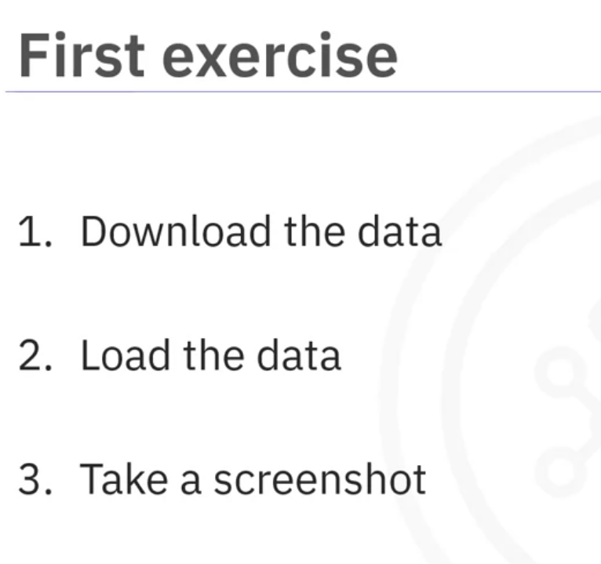
The first exercise requires you to load the data provided by the company into the tables in CSV format by performing a series of tasks.
You will start by downloading the data from the links provided and then
load that data into the DimDate table, DimCategory table, DimCountry table, and fact table FactSales.
And after loading the data, you will take a screenshot of the first five rows in each table and name the screenshot.

Slide 3
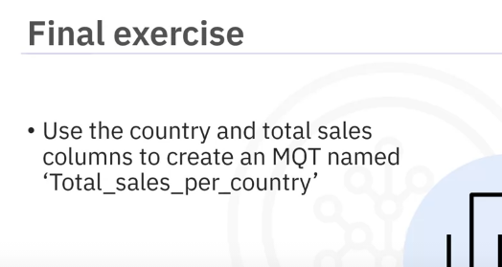
Finally, you will create a Materialized Query Table or MQT named Total_sales_per_country using the country and total sales columns.
After performing each task, you will take a screenshot of the SQL and the output rows and then name the screenshot.

